Slide 1



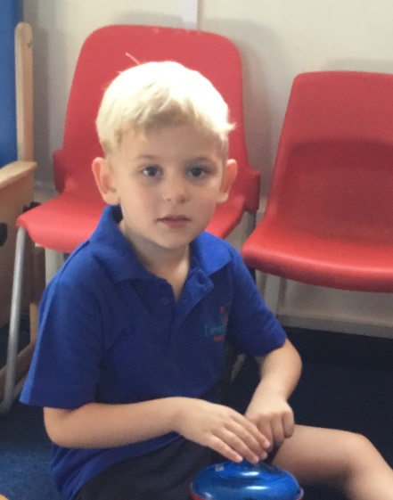
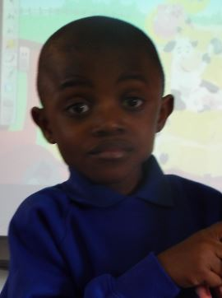
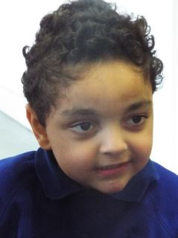
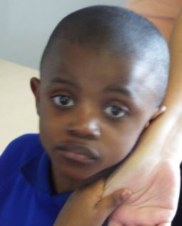
Achievement Award
Ziggy
For concentrating and engaging so well in our art lesson this week.
Well done Ziggy!
Date: 3rd December 2021

Slide 2
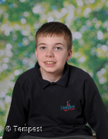
Achievement Award
Alex
For finding an adult and asking for help to unlock the gate.
Well done Alex!
Date: 3rd December 2021

Slide 3
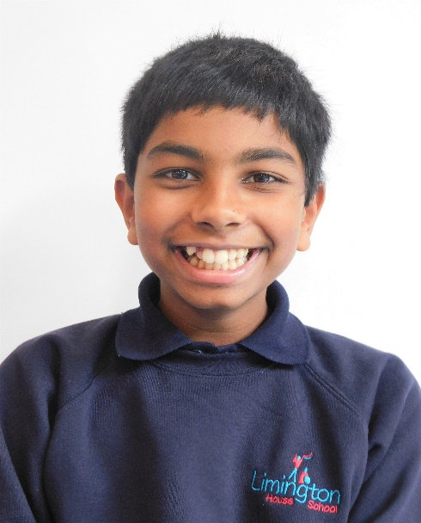
Achievement Award
Nalin
For successfully following instructions in the swimming pool when on his front and back.
Well done Nalin!
Date: 3rd December 2021

Slide 4
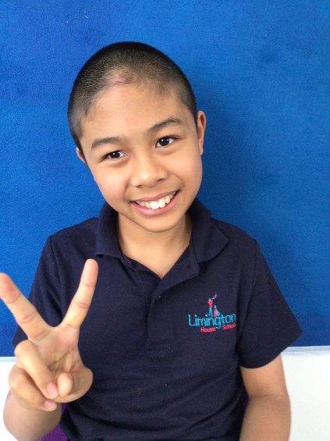
Achievement Award
Elwyn
For helping a friend with a job outside of class and taking the register to reception independently.
Well done Elwyn!
Date: 3rd December 2021

Slide 5
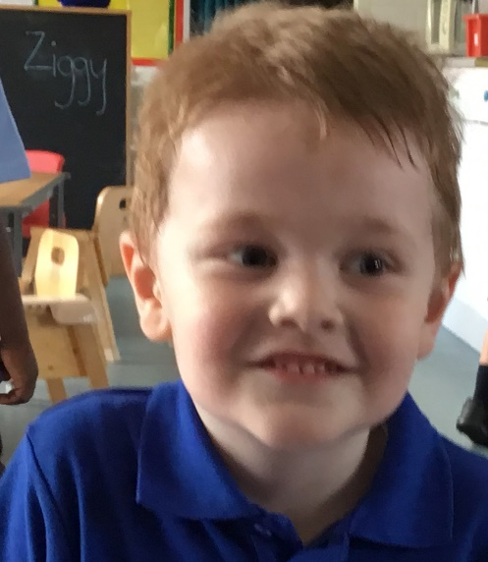
Communicator of the Week
Reggie
For requesting and travelling independently to an adult with song choices.
Well done Reggie!
Date: 3rd December 2021

Slide 6
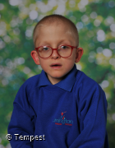
Communicator of the Week
Alex
For learning and remembering lots of new makaton signs this week - he has even started using them to request the toilet.
Well done Alex!
Date: 3rd December 2021

Slide 7
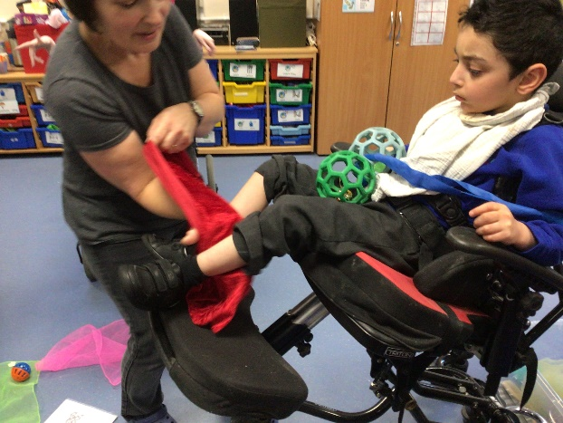
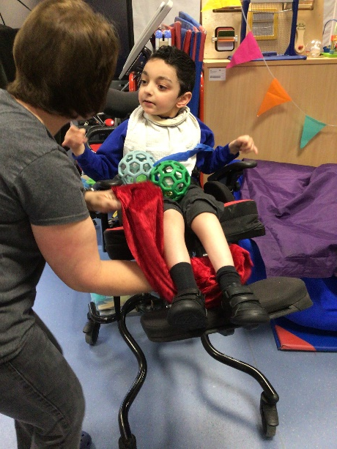
Communicator of the Week
Usman
For lifting his legs up and giving great eye contact to request more during our Tac Pac session.
Well done Usman !
Date: 3rd December 2021

