Slide 1



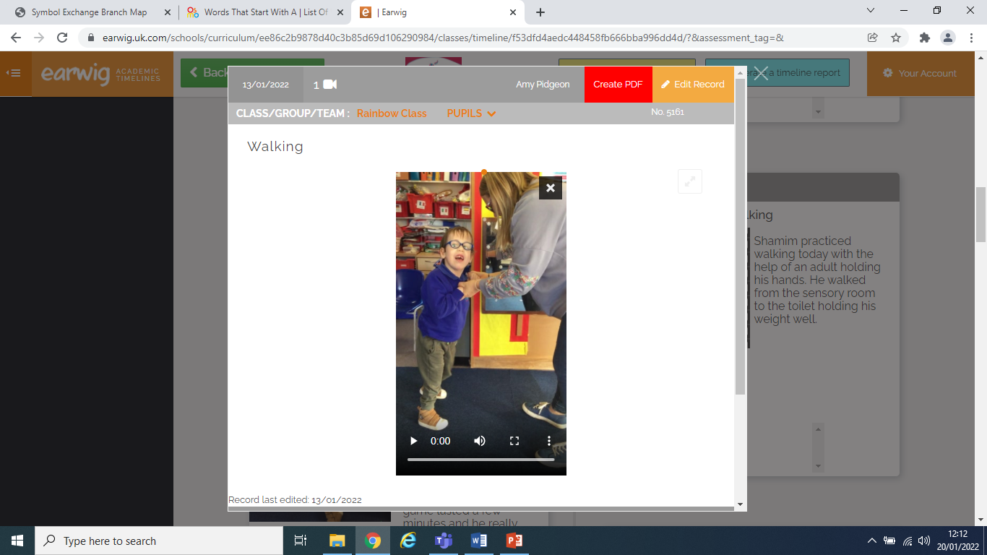
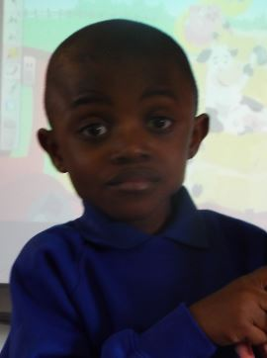
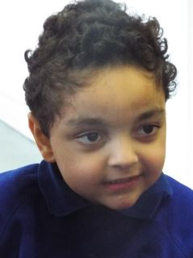
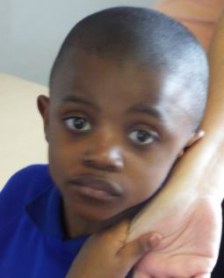
Achievement Award
Shamim
For walking confidently with the support of an adult.
Well done Shamim!
Date: 21st January 2022

Slide 2
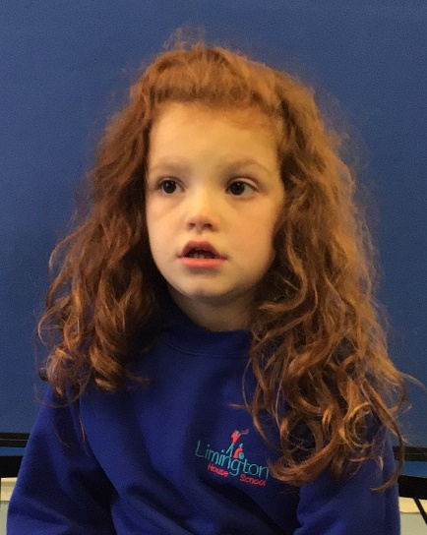
Achievement Award
Miah-Rose
For engaging independently in chatterbox time alongside her peers.
Well done Miah!
Date: 21st January 2022

Slide 3
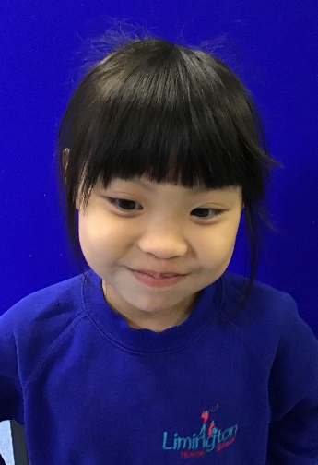
Achievement Award
Amanda
For fantastic sentence work in literacy – successfully making subject, verb, object sentences independently to describe pictures.
Well done Amanda!
Date: 21st January 2022

Slide 4
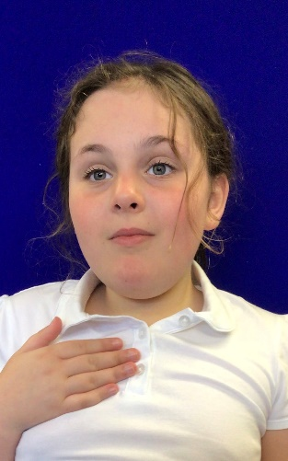
Achievement Award
Mia
For waiting calmly and patiently on poolside for her turn, getting out when asked and changing sensibly.
Well done Mia!
Date: 21st January 2022

Slide 5
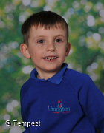
Achievement Award
Brody
For following instructions our PE lesson - running, galloping and skipping.
Well done Brody!
Date: 21st January 2022

Slide 6
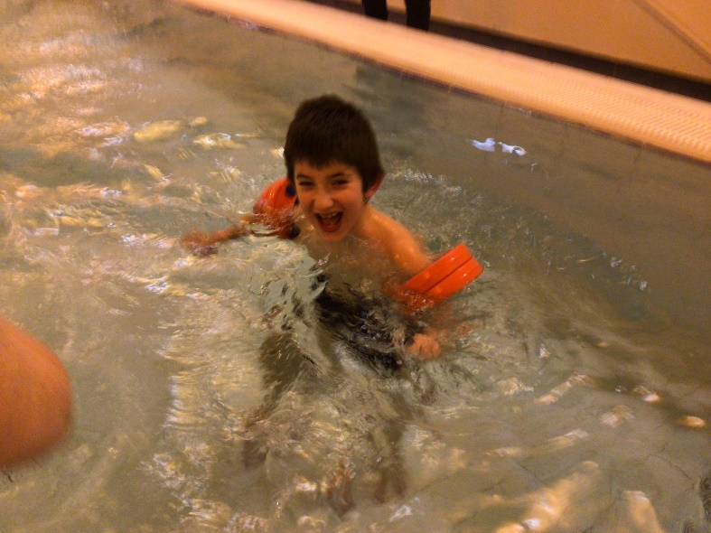
Achievement Award
Ercan
For a brilliant swim, following instructions and waiting patiently for his turn.
Well done Ercan!
Date: 21st January 2022

Slide 7
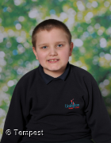
Achievement Award
Jayden
For coming into class calmly all week, getting straight on with his morning work and doing his best in all lessons.
Well done Jayden!
Date: 21st January 2022

Slide 8
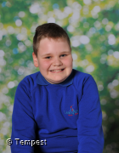
Achievement Award
Jakub
For successfully completing a maths subtraction worksheet almost entirely independently!
Well done Jakub !
Date: 21st January 2022

Slide 9
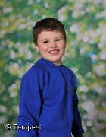
Achievement Award
Alex
For working hard to complete some workstation activities.
Well done Alex!
Date: 21st January 2022

Slide 10
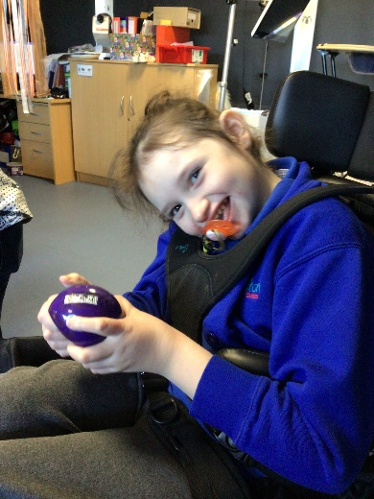
Achievement Award
Brycie
For successfully using her hands to explore new items presented to her.
Well done Brycie!
Date: 21st January 2022

Slide 11
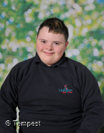
Achievement Award
Preston
For trying hard when sounding out CVC words in our snakes and ladders reading game.
Well done Preston!
Date: 21st January 2022

Slide 12
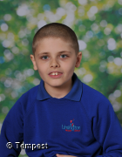
Achievement Award
Cameron
For successfully following instructions in our food technology session.
Well done Cameron!
Date: 21st January 2022

Slide 13
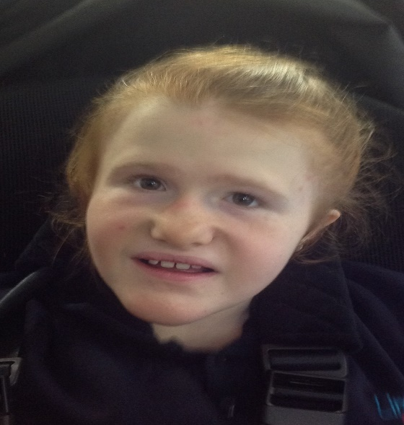
Achievement Award
Sophia
For standing at the side of the pool with minimal support to reach for toys.
Well done Sophia!
Date: 21st January 2022

Slide 14
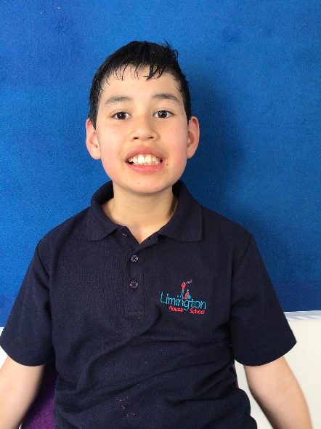
Achievement Award
Freddie
For using his initiative by choosing and displaying the correct symbols for the class timetable.
Well done Freddie!
Date: 21st January 2022

Slide 15
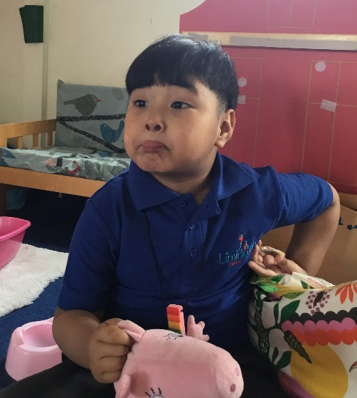
Communicator of the Week
Aarav
For using his PECS to successfully request different toys during our choice session.
Well done Aarav!
Date: 21st January 2022

Slide 16
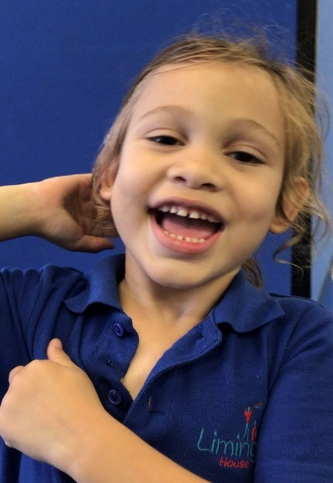
Communicator of the Week
Maximus
For using his PECS consistently at PECS Stage 3b – making choices, starting to find symbols in his folder and requesting food items from an adult.
Well done Max!
Date: 21st January 2022

Slide 17
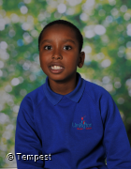
Communicator of the Week
Joseph
For independently using his PECS to request his ear defenders.
Well done Joseph!
Date: 21st January 2022

Slide 18
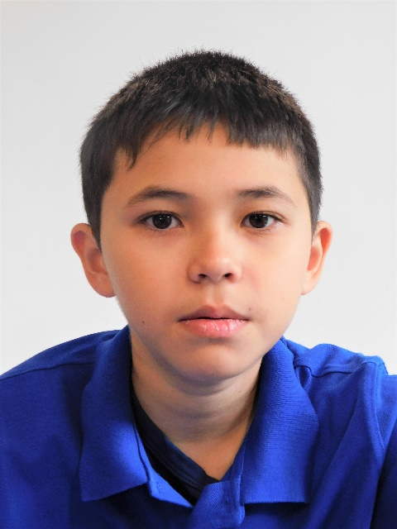
Communicator of the Week
Toby
For finding and then successfully using the class choice board to choose what programme he wanted to access.
Well done Toby!
Date: 21st January 2022

Slide 19
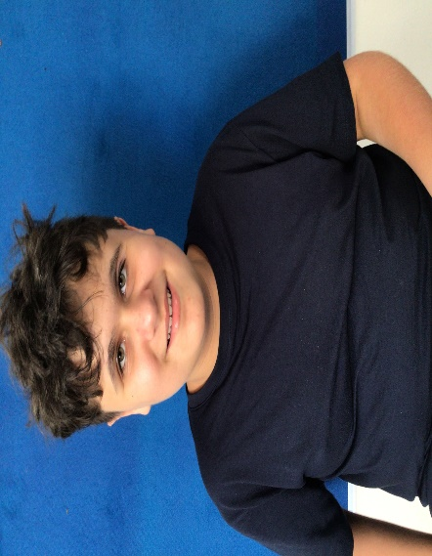
Communicator of the Week
Daniel
For successfully using his communicator to tell a member of the class team that he was not feeling very well.
Well done Daniel!
Date: 21st January 2022

